Slide 1

Java Teamwork Project
Cards Memory Game
by Team “Lotte World”

Slide 2
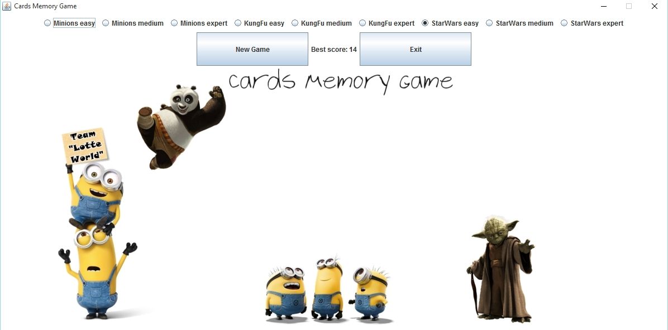
Our project represents a card-matching memory game with three themes and levels, which can be choose by the user.

Slide 3
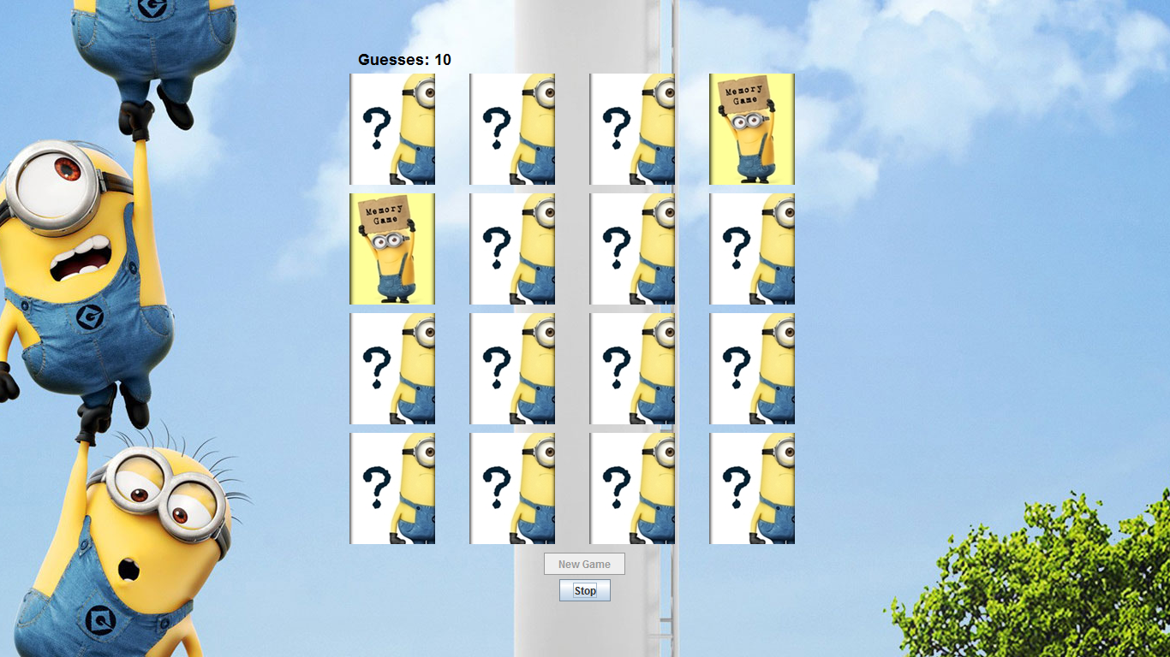
For the graphical user interface we used Swing. We have counter to count the guesses made, randomly sorted cards and a text message after the game depends of how good the user was played.

Slide 4
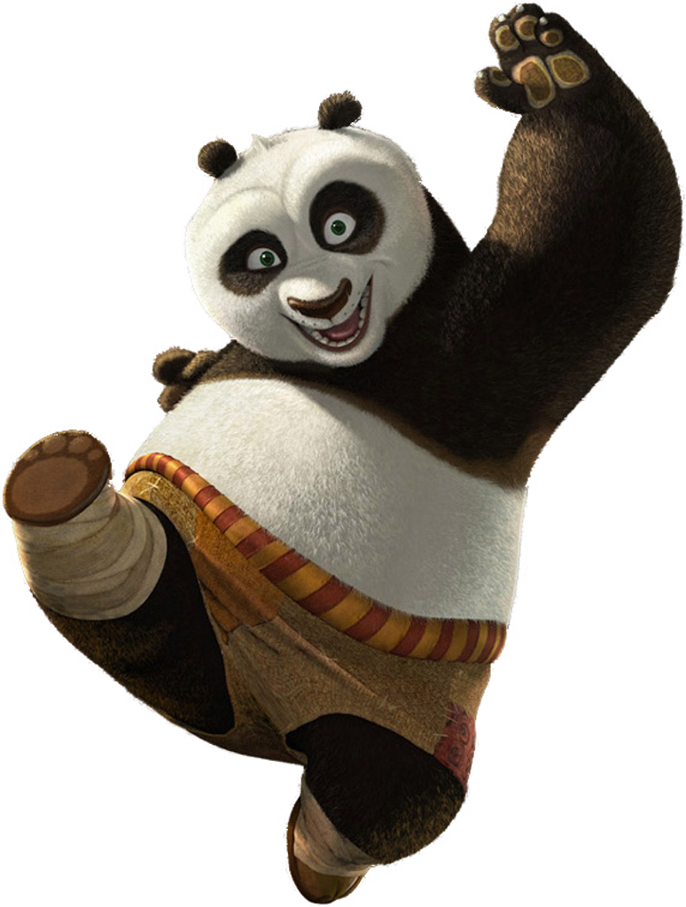
Members of team “Lotte world”
Dimitar Klaturov - bulgaria_mitko
Ивайло Арсов - IvoArsov
Ivan Manin - MaNiN
Zhecho Mitev - zhecho15
Mirela Damyanova - mirela95
Mihail Mihaylov - mishomihaylov
Ventsislav Georgiev - VentsislavGeorgiev

